Slide 1
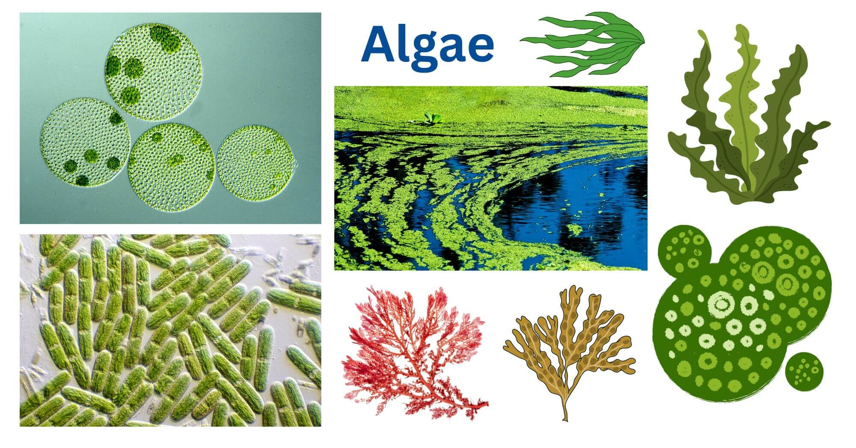
Algae
General Characteristics of Algae
Dr. Trilok Kumar
Assistant Professor
Govt. Digvijay Autonomous PG College, Rajnandgaon, C.G.

Slide 2
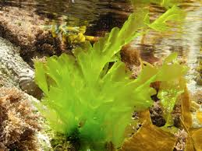
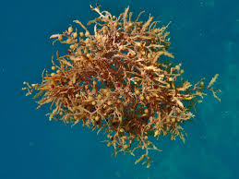
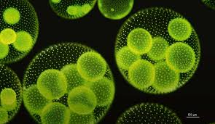
Algae
Study of Algae - Phycology
Definition
Eukaryotic, Thallophytic, Photosynthetic, Avascular, Cryptogamus plants are called Algae.
Term Algae- Latin word. First used by Linnaeus (1754) for
Seaweed.

Slide 3
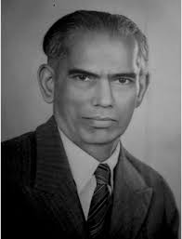
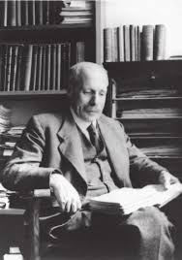
Algae
Father of Indian Phycology: M.O.P. Iyenger
Father of World Phycology: F. E. Fritsch
In World: 2475 Genera of algae & 28305 Species of algae
In India: 666 Genera of algae & 5136 Species of algae

Slide 4
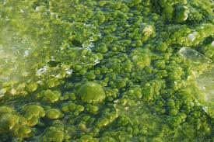
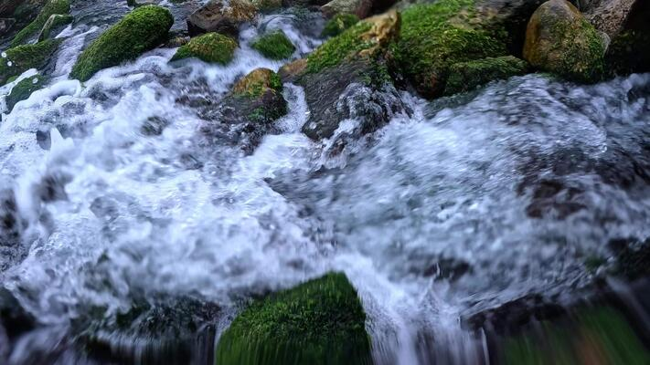
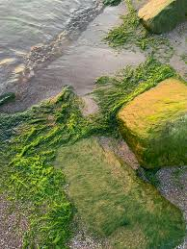
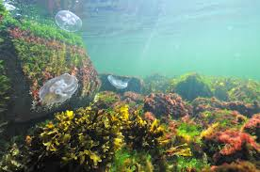
Characteristic features of Algae
They are aquatic, found in fresh water, non-salty & salty water of sea.
They also found in moist soil and rocks.
Fresh water Algae
Spring water Algae
Algae on moist soil & Rocks
Marine algae

Slide 5
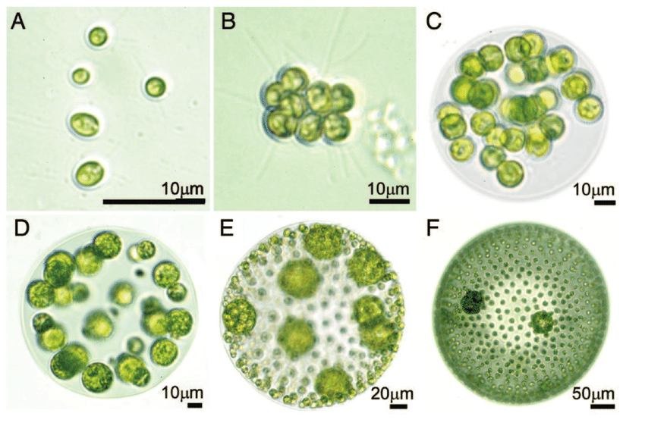
Characteristic features of Algae
Plant body: unicellular to multicellular (Thalloid- Not differentiated into root, stem and leaves).
Each algal cell contains chloroplast, mitochondria, nucleus, GB, eye spot, contractile vacuoles etc.
Fig: Examples of unicellular and multicellular algae in the Chlorophyte taxon. (a) the unicellular species Chlamydomonas reinhardtii; (b) a colony of Gonium pectorale; (c) a colony of Eudorina elegans; (d) the multicellular species Pleodorina californica; (e) the multicellular species Volvox carteri; (f) the multicellular species Volvox aureus Michod (2007).

Slide 6
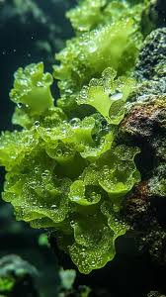
Characteristic features of Algae
Autotrophic in nature (+nt Chlorophyll).

Slide 7
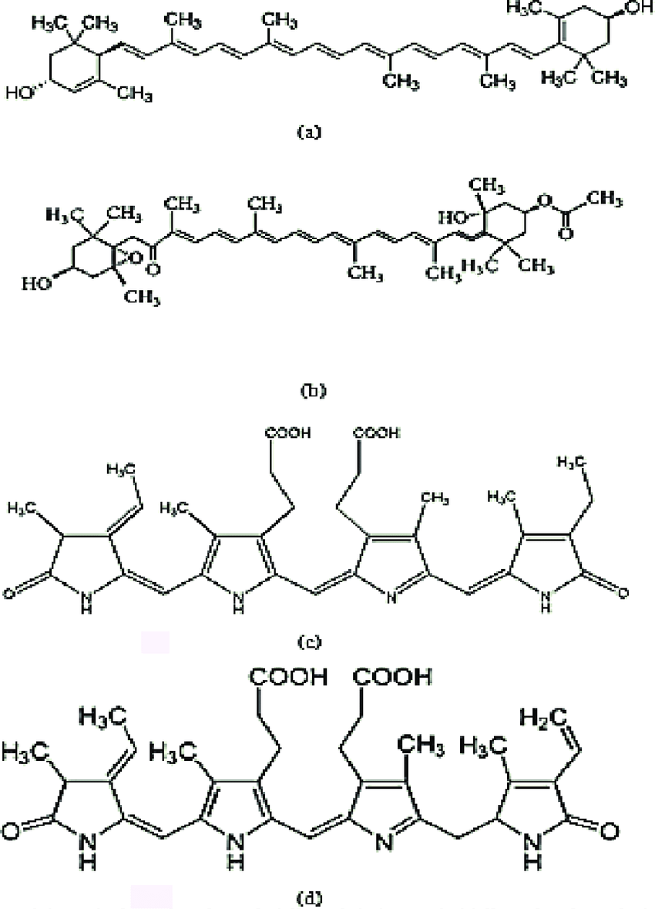
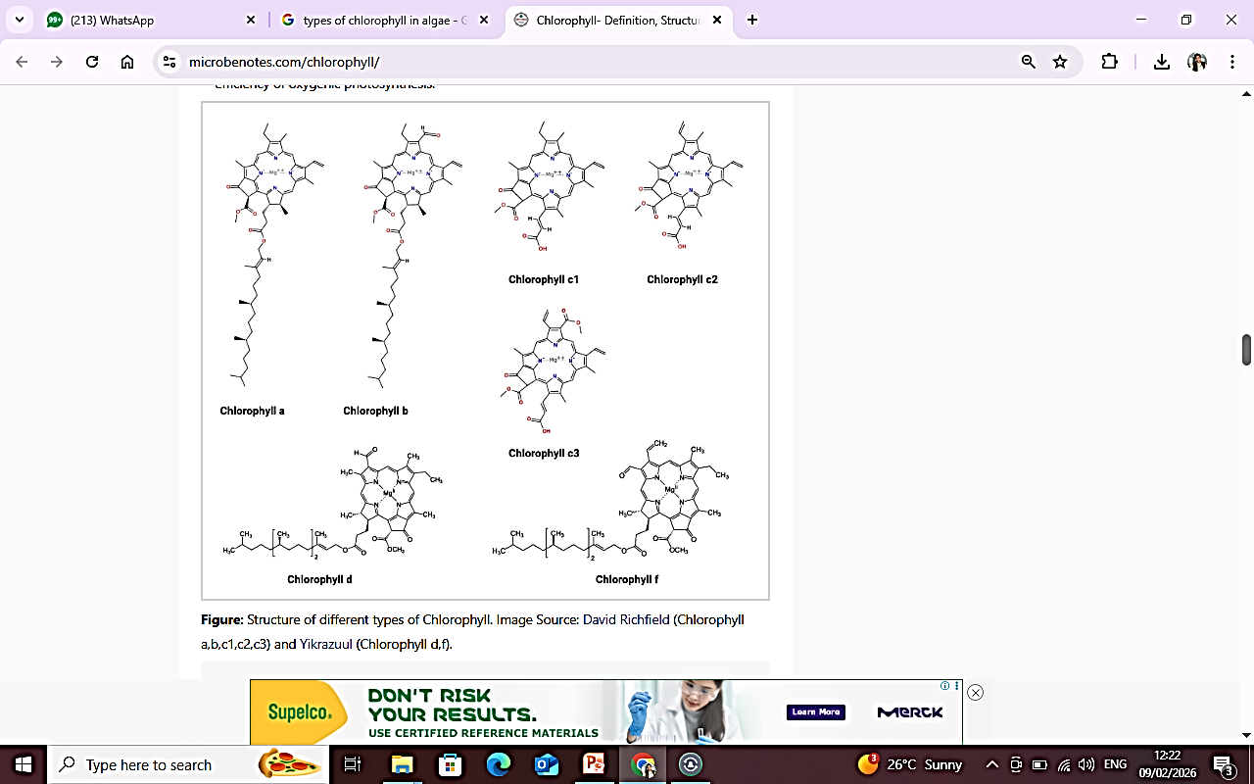
Characteristic features of Algae
Different types of chlorophyll are +nt- a, b, c, d, Beta carotene, xanthophyll, fucoxanthin, c & r phycocyanin and phycoerythrin.
Fig: The structure of the pigments: (a) xanthophyll (b) Fucoxanthin (c) Phycocyanin and (d) Phycoerythrin

Slide 8
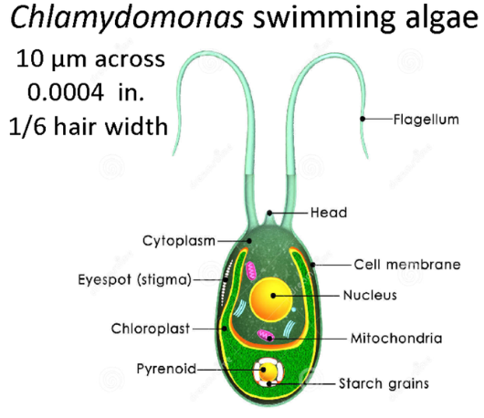
Characteristic features of Algae
Motile algae have flagella. The no. of flagella varies from 1 to 6.
Reserve food material in algae: Starch (Usually), fat & oil droplets, Laminarin, Mannitol, Floridian starch, cyanophycean starch.

Slide 9

Characteristic features of Algae
Reproduction by 3 methods: 1 Vegetative, 2. Asexual 3. Sexual
Sexual reproduction may be Isogamatic, heterogamtic or oogamous.
Both Gametes are similar Both Gametes are dissimilar Female Gamete non-motile
while male is motile
Sexual reproduction takes place by Gametes.
Sex organs are Simple and Unicellular.
Zygote forms after fertilization. Zygote divides meiotically to produce new thallus.

Slide 10
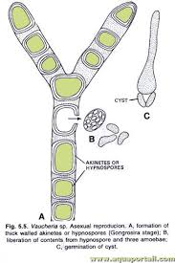
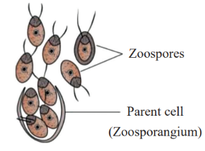
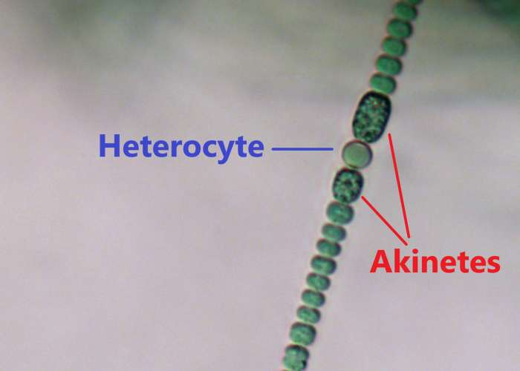
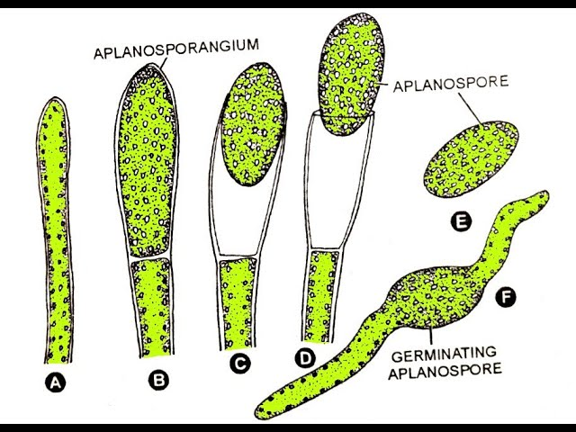
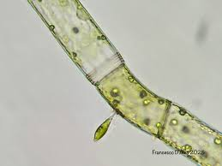
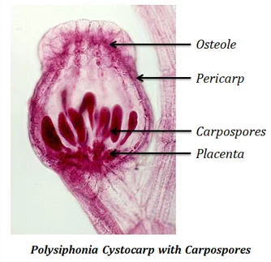
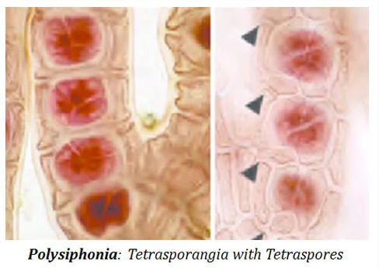
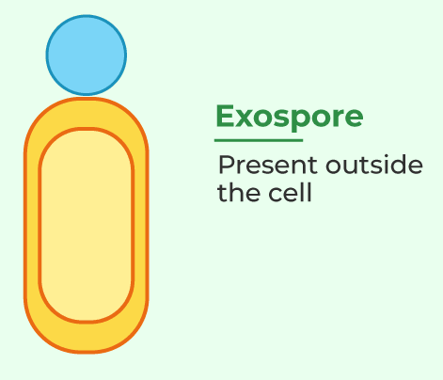
Characteristic features of Algae
Asexual reproduction take place by means of Zoospore, Aplanospores, Hypnospores, Akinetes, Androspores, exospores, carpospores or tetraspores.
Zoospore in Volvox Aplanospores in Vaucheria Hypnospores, Anabaena: Akinetes
Androspores in Oedogonium
Exospores

Slide 11
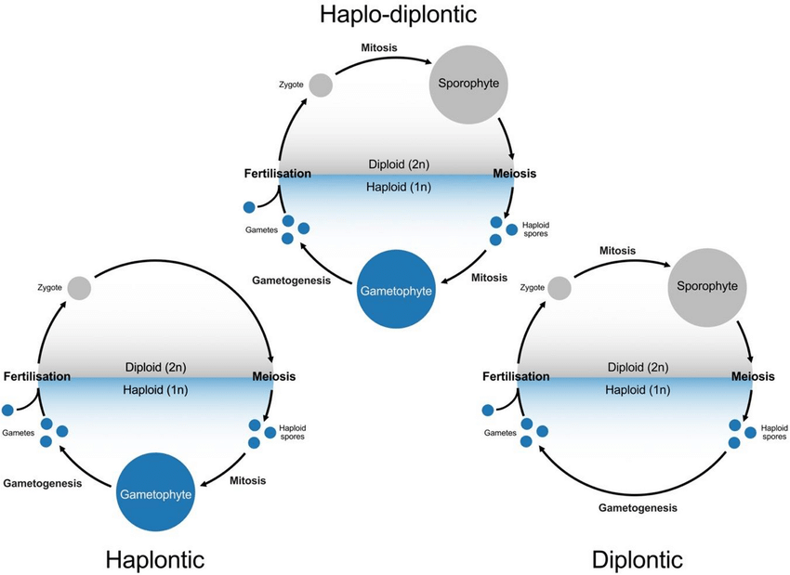
Characteristic features of Algae
Alternation of generation +nt.
Types: Haplobiontic, Diplobiontic and Haplodiplobiontic.

Slide 12
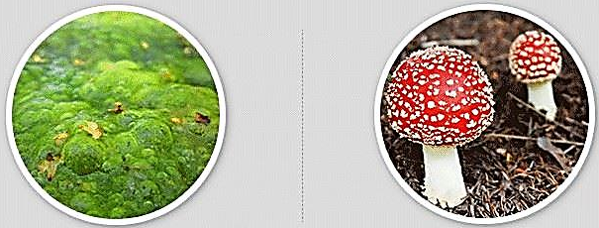
Difference between Algae and Fungi
Algae | Fungi

Slide 13
Difference between Algae and Fungi
Algae | Fungi
Plant body: Unicellular, multicellular, filamentous, branched or unbranched. Mycelium is absent. | Plant body unicellular or multicellular, Each filament is known as Hyphae. Large no. od Hyphae constitutes a mycelium
Chlorophyll: +nt | Chlorophyll: -nt
Autotrophic: Photosynthesis | Heterotrophic: Parasitic or saprophytic
Thallus made up of Parenchymatous cells. | Thallus made up of Psedoparenchymatous cells.
Cell wall made up of cellulose. | Cell wall made up of Chitin.
RFM: Starch | RFM: Glycogen & oil droplets.

